Slide 1
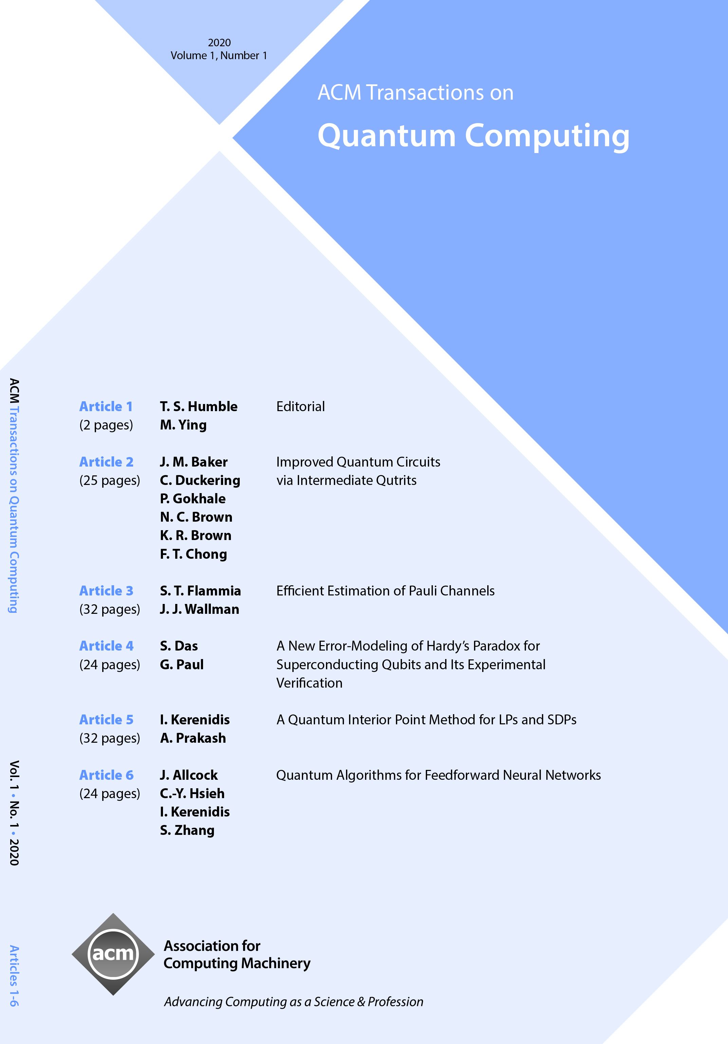
ACM Transactions on Quantum Computing (TQC)
Co-Editors-in-Chief
Travis S. Humble, Oak Ridge National Laboratory (USA)
Mingsheng Ying, Institute of Software, Chinese Academy of Sciences (China)
ACM Transactions on Quantum Computing (TQC) publishes high-impact, original research papers and selected surveys on topics in quantum computing and quantum information science on a quarterly basis. The journal targets the quantum computer science community with a focus on the theory and practice of quantum computing. It welcomes submissions that address computational aspects of quantum computing in particular and appeal to the broader community of quantum information science.
https://tqc.acm.org

